Slide 1


CSE 446 Software Integration and Engineering
Unit 1 Service Standards and Service Development
Lecture 1-4 REST Concept and Architecture
Dr. Yinong Chen
https://myasucourses.asu.edu/

Slide 2
Lecture Outline
HTTP
REST Concept
RESTful Services
From SOAP service to RESTful Service
When to use SOAP services and when to use RESTful services?
Processing URI string in RESTful service
Mapping URI string to operations
Output formats
Microservice architecture

Slide 3
HTTP (Version 1.1)
http://www.w3.org/Protocols/rfc2616/rfc2616.html
HTTP is an application-level protocol for distributed, collaborative, and hypermedia information systems.
HTTP messages are always two ways: requests from client to server and responses from server to client.
HTTP-message = Request | Response
Request: Request-Line =
Method SP Request-URI SP HTTP-Version CRLF
Response: Status-Line =
HTTP-Version SP Status-Code SP Reason-Phrase CRLF
where, SP: Space and CRLF: end of line mark
Syntax

Slide 4
HTTP Methods
The Method indicates the operation to be performed on the resource identified by the Request-URI. The method is case-sensitive.
GET
retrieves the information (entity) identified by Request-URI.
If the Request-URI refers to a data-producing process (operation), the produced data shall be returned in the response.
HEAD
The HEAD method is identical to GET, except that the server MUST NOT return a message-body in the response.
Used to obtain meta-information about the entity implied by the request without transferring the entity-body itself.
Use for making one-way call – no message body to return.

Slide 5
HTTP Methods (contd.)
PUT: For creating and modifying/replacing resource. It requests the enclosed entity to be stored under the supplied Request-URI.
POST: used to request the server to accept the (data) entity enclosed in the request as a new subordinate of the resource identified by the Request-URI in the Request-Line.
POST and PUT have some similarity, but are used in different situations:
POST: append;
PUT: replace or create
append
replace

Slide 6
HTTP Methods (contd.)
DELETE: requests that the origin server deletes the resource identified by the Request-URI.
The client cannot be guaranteed that the operation has been carried out, even if the status code returned from the origin server indicates that the action is successful. Why?
However, the server SHOULD NOT indicate success unless, at the time the response is given, it intends to delete the resource or move it to an inaccessible location.
TRACE: invoke a remote, application-layer loop-back of the request message.
CONNECT: for use with a proxy that can dynamically switch to a tunnel (e.g. SSL tunneling)
Not to hold the client for too long

Slide 7
REST and RESTful Service
REST (Representational State Transfer) is a style of software architecture for distributed hypermedia systems such as the World Wide Web.
Proposed by Roy Thomas Fielding in his doctoral dissertation "Architectural Styles and the Design of Network-based Software Architectures" in 2000.
Fielding is one of the principal authors of the HTTP specification versions 1.0 (1996) and 1.1 (1999).
Services developed based on REST concept and conforming to the REST constraints are referred to as RESTful services. http://en.wikipedia.org/wiki/Representational_State_Transfer

Slide 8
REST Concept
REST concept is about how communication is done between clients and servers using HTTP at the application level. REST concept is defined by these principles:
A client initiates a request to a server;
The server processes the request and returns a response;
Communication is stateless;
Communication is about the "representations" transfer of "resources" between a client and a server;
Each resource is given a unique identifier, called URI (Universal Resource Identifier).

Slide 9
REST Architecture and REST Constraints
REST architecture is a software development style that follows these design constraints and guidelines:
Client-server separation: Clients and servers are logically separated and communicate through a uniform interface conforming to HTTP.
Stateless: Every request from a client is considered from a new client by the server.
Client-side cacheable: The response delivered from the sever must contain the complete information for the client to reuse the response, if the client requests the same URI. – Output Caching on client side (Textbook 5.5).

Slide 10
REST Architecture and REST Constraints (contd.)
Layered architecture: A server is a logical unit with a layered architecture.
A client identifies a server by an URI.
The resource may or may not reside on the server that the client is communicating with.
The request can be redirected to another server transparently.
Multiple redirections are possible.
Code on demand: A server may process the request by executing a program on the server side or sending the code (script) to the client side to process.

Slide 11
What is New?
The concept, the principles, and the constraints all sound familiar.
We have been applying them to design Web 1.0 (Static Web presenting data);
What is about Web 2.0 (Web as the computing platform)? Move from data Web to computing Web.
SOAP/WSDL Web services: create computing-based Web.
RESTful services: create data-oriented computing Web
Spiral: Data Web (no computing) → Computing Web → Data Web (with invisible computing behind)

Slide 12

Spiral Advancement Models of Technology
Data Web with invisible computing
Centralized Computing (Cloud Computing)
Computing Web
Distributed Computing
Data Web without computing
Centralized Computing (mainframe)

Slide 13
SOAP-Service vs. RESTful Service
Providing a service generally involves two issues:
Performing (verb) a certain task for a client, and
the result (noun) of performing the task;
SOAP-Services:
Focus on the verb “performing” the task;
Access a remote method/procedure;
Based on class concept of object-oriented language, developed by OO people.
Heavy-weighted services, just like classes.
RESTful Services:
Focus on the noun “result” of performing the task;
Access a “resource” instead of a method,
Based on communication protocol and developed by HTTP people;
Can be called even in script languages.
Light-weighted service

Slide 14
RESTful Services are More Web Oriented
Based on HTTP and Web browser;
Can be accessed in Web browser;
Just like a Web page, they can be viewed and bookmarked in a browser;
The results can be cached and reused, through browser’s built-in caching mechanism;
RESTful services can be called in any programming languages, including script languages, that can make HTTP call.

Slide 15
Developing a Basic RESTful Service in WCF
Windows Communication Foundation has decoupled the interface generation from the development environment. It enables
WSDL/SOAP interface;
.Net - .Net Remoting interface
RESTful service interface (HTTP interface).
Using WCF:
Develop a WCF service
Make a few changes to obtain RESTful service

Slide 16
From a SOAP Service to a RESTful Service
Textbook Chapter 7.3 on RESTful services
Create a SOAP-based Service in WCF;
Use a client to test the service to make sure it works;
Convert the SOAP-based Service into a RESTful service in follow steps:
Add “using Sytem.ServiceModel.Web” in file IService.cs;
Add the attributes [WebGet] for each operation contract
Add the following line in the service’s markup source code Factory="System.ServiceModel.Activation.WebServiceHostFactory"
Remove SOAP endpoint for access, so that HTTP can be directly used for accessing the service.

Slide 17
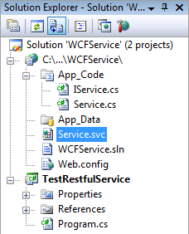
From a SOAP Service to a RESTful Service
//IService.cs
using System.ServiceModel;
using System.ServiceModel.Web; // Add this namespace
[ServiceContract]
public interface Iservice {
[OperationContract]
[WebGet] // Add this HTTP GET attribute/directive
string GetData(int value);
[OperationContract]
[WebGet] // Add this HTTP GET attribute/directive
double PiValue();
[OperationContract]
[WebGet] // Add this HTTP GET attribute/directive
int absValue(int intValue);
}
1
2
Service.cs
file remains unchanged
1
[1] if not available, you need to use Add Reference and find it in framework library.

Slide 18
Use WebServiceHostFactory for Hosting
Right-click the file Service.svc and choose “View Markup”. The markup source code of the file is open, as shown below:
Add one line of code in the source file, which results in the code below:
<%@ ServiceHost Language="C#" Debug="true" Service="Service" CodeBehind="~/App_Code/Service.cs"
Factory="System.ServiceModel.Activation.WebServiceHostFactory" %>
3
WebServiceHostFactory will automatically search all the methods in the service to match the requirement of the incoming URI

Slide 19
Remove SOAP Endpoint
4
Open Web.config file, remove the entire <system.serviceModel> element, which will remove the SOAP endpoints.
RESTful services do not support the SOAP-endpoint-based access.
Removing this element will immediately disable the accesses from service proxies from all kinds of SOAP clients.

Slide 20
Remove SOAP Endpoint in Configuration
<system.serviceModel>
<services>
<service name="Service" behaviorConfiguration="ServiceBehavior">
<!-- Service Endpoints -->
<endpoint address="" binding="wsHttpBinding" contract="IService">
<identity>
<dns value="localhost"/>
</identity>
</endpoint>
<endpoint address="mex" binding="mexHttpBinding" contract="IMetadataExchange"/>
</service>
</services>
</system.serviceModel>

Slide 21
Consuming the RESTful Service
Now, if we start the service in a browser after the modification above, the browser will open a page at the address: http://localhost:51191/myWcfRestService/Service.svc
It displays an error message of “Endpoint not found”.
This is because that the endpoints have been removed in the Web.config file and the service is no longer a SOAP service.
We need to use a different protocol (HTTP) to consume (test) a RESTful service.

Slide 22
Consuming the RESTful Service
After starting the service, the simplest way of consuming a RESTful service is to type the URI in a browser, with the method name and parameter value as a part of the URI.
http://localhost:51952/WCFService/Service.svc/PiValue
It returns: 3.1415926535897931
http://localhost:51952/WCFService/Service.svc/absValue?intValue=-25
It returns: 25

Slide 23
Is the Service Developed a RESTful Service?
The developed service has removed SOAP, and it uses HTTP method GET to access the resources (operations);
It can be accessed using in a browser;
However, it still focuses on operations (methods), instead of the results and data: We put the service name, method name and parameters in the URI:
http://localhost:51952/WCFService/Service.svc/PiValue
http://localhost:51952/WCFService/Service.svc/absValue?intValue=-25
We can hide the method name to make it more like a RESTful service.
We will show more development details in the next lecture. Now, we continue to explain the concept.

Slide 24
The Key Ideas of RESTful Services
Use HTTP directly without another layer of SOAP. As the focus is on exposing the resources, the HTTP verbs GET, PUT, POST, DELETE, and HEAD are sufficient for accessing the RESTful services.
Focus on exposing data and resources instead of Web methods. Each resource is given a URI, and a set of resources can also be assigned to a URI.
RESTful service development is about identifying resources to be exposed, and organizing them so that the resources can be exposed efficiently in different ways: individually or in sets.

Slide 25
Co-Exist of SOAP and RESTful Services
We can use either (SOAP or RESTful) to do both (access methods and access data/resource);
SOAP service
way
WebMethod
Data/Resource
RESTful service
way
Data/Resource
WebMethod
We should use SOAP services for computation-oriented tasks: Solving equations, find the shortest path, etc.
We should use RESTful services for data and resource-oriented tasks: finding photos, finding books, etc.

Slide 26
Example: A Book Management System
We can save the information of all the books in a relational database with a schema,
(authors, title, isbn, year, publisher, keywords)
authors | title | isbn | year | publisher | keywords
Aaron | OS | 123456789 | 2010 | Kendall | Linux
John | Database | 987654321 | 1999 | Apress | relational
Chen | Programming | 0757529747 | 2006 | Kendall | Language
Chen | Protocol testing | 3181460109 | 1993 | VDI Verlag | Communication
. . .

Slide 27
Example: a Book Management System SOAP-Service Approach
For the given schema:
(authors, title, isbn, year, publisher, keywords)
you define a class with the following operations/methods:
search_by_author(string author);
search_by_title(string title);
search_by_isbn(string isbn);
search_by_year(string year);
search_by_publisher(string publisher);
search_by_year_publisher(string year, string publisher);
Define WSDL interface:
Service
Endpoints
Operation
Input message
Output message
Two parameters
Two parameters

Slide 28
Example: Book Management System RESTful Service Approach
Represent the resources in a resource tree, which is a rooted tree with the root representing all resources, and each tree node representing a subset of resources of its parent node:

Slide 29
Mapping Tree Nodes to Resource Sets
{all books} → http://mylib.asu.edu/
/ (root)
{books | author = Aaron} → http://mylib.asu.edu/authors/{author=Aaron}
…
{books | author = Zeta} → http://mylib.asu.edu/authors/{author=Zeta}
authors/
titles/
isbns/
years/
publishers/
year/publishers/
{books | title = OS} → http://mylib.asu.edu/titles/{title = OS}
…
{books | title = SOA} → http://mylib.asu.edu/titles/{title = SOA}
{book | year= 1900} → http://mylib.asu.edu/years/{year= 1900}
…
{books | year=2010} → http://mylib.asu.edu/years/{year= 2010}
{books | year=2010}/{publishers | publisher=Kendallhunt}
→ http://mylib.asu.edu/years/{year= 2010}/publishers/publisher=Kendallhunt}

Slide 30
Using URI to Access Resources
Method-Oriented Resource Access in URI:
http://localhost:51952/WCFService/Service.svc/absValue?intValue=-25
http://mylib.asu.edu/bookService.svc/search_by_author?author=Aaron
Result-Oriented Resource Access in URI: http://mylib.asu.edu/authors/{author=Aaron}
How is this URI mapped to resource: all books written by Aaron?
map
How to map?
search_by_author(string author);

Slide 31
How to map URI to a Method behind?
String-process the incoming URI and obtains words in the string;
Match URI to the service
Identify the method that can process the request.
Find any variables and variable values in the URI and map them to the method parameters and parameter values.
Determine the HTTP method (GET, POST, PUT, etc.) used in the request and whether it’s allowed for the resource.
Read the resource representation found in the entity body (if any).
Combine all of this information to perform the underlying service logic (or call the corresponding method).
Generate an appropriate HTTP response, including the proper status code, description, and outgoing resource representation in the response entity body (if any).

Slide 32
WCF Support to URI Process
http://msdn.microsoft.com/en-us/library/bb675245.aspx
We could implement RESTful service concept without a programming environment support, e.g., string processing. The program will be extreme long & tedious.
WCF provides mechanisms and classes to facilitate the implementation of RESTful services, for example
Uri: convert a string into a URI object
UriTemplate: Define the template of input URI
UriTemplateMatch: Match two URIs
Example: to match the built-in and incoming URIs:
http://mylib.asu.edu/years/{year=2010}/authors/{author=Aaron}
http://mylib.asu.edu/years/publishers/authors,

Slide 33
URI Processing
UriTemplate Class
The built-in URI template:
http://mylib.asu.edu/years/{year=2010}/authors/{author=Aaron}
UriTemplateMatch
http://mylib.asu.edu/years/publishers/authors
(Client entered this URI in a browser)

Slide 34
Example: Analyze the Incoming URI String
using System;
using System.ServiceModel.Web;
class ConsoleAppUriMatch {
static void Main(string[] args) {
Uri baseUri = new Uri("http://mylib.asu.edu");
UriTemplate myTemplate = new UriTemplate("/{years}/{publishers}/{authors}");
Console.WriteLine("Built-in URI path segments are");
foreach (var segName in myTemplate.PathSegmentVariableNames) {
Console.WriteLine(segName);
}
Console.WriteLine("Please enter the Incoming URI with path segments ");
string myUri = Console.ReadLine();
// enter this URI: http://mylib.asu.edu/years/publishers/authors

Slide 35
Example: Analyze the Incoming URI String
// CONTINUED FROM LAST PAGE
Uri incomeUri = new Uri(myUri); // convert string into URI format
UriTemplateMatch myMatch = myTemplate.Match(baseUri, incomeUri);
if (myMatch != null) {
var matched = myMatch.BoundVariables;
string myVars;
foreach (var k in matched.Keys) {
myVars = k.ToString();
Console.WriteLine("{0} = {1}", myVars, matched[myVars]);
}
}
else
Console.WriteLine("The incoming URI does not match the built-in URI");
}
}

Slide 36
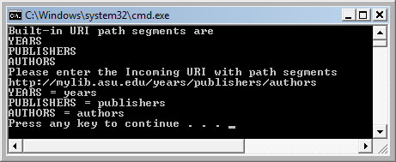
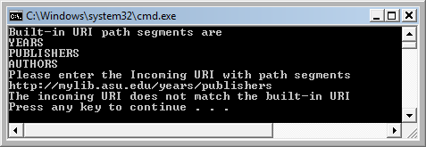
Output of the Program
Executing the program with a matching incoming URI:
For other inputs

Slide 37
Composing URI Using WCF Built-in Classes
// create the base address
Uri baseUri = new Uri("http://mylib.asu.edu");
// create the path from tree root to the child node
UriTemplate myTemplate = new
UriTemplate("years/{year}/publishers/{publisher}");
// Assign values to variable to complete URI
Uri newBooksUri =
myTemplate.BindByPosition(baseUri, "2010", "Kendallhunt");
// create the path from tree root to the child node
myTemplate = new UriTemplate("authors/{author}");
// Assign values to variable to complete URI
newBooksUri = myTemplate.BindByPosition(baseUri, "Aaron");

Slide 38
Define the Map from URI to Methods
[ServiceContract]
public partial class BookService {
[WebGet(UriTemplate = "{author}?tag={tag}")] //search by author
[OperationContract]
Books search_by_author(string username, string tag) {...}
[WebGet(UriTemplate = "{title}?tag={tag}")] //search by title
[OperationContract]
Books search_by_title(string title, string tag) {...}
//search by year and by publisher
[WebGet(UriTemplate = “years/{year}/publishers/{publisher}")]
[OperationContract]
Books search_by_year_publisher(string year, string publisher) {...}
...
}

Slide 39
Resource Representations
In many cases, a URI request will return a set of items.
For example, the URI http://mylib.asu.edu/years/{year=1999} will return all books in 1999 in the library.
How do we present the data to the user who made the request?
XML: Requires XML schema
POX (Plain Old XML): A simple XML with given schema
RSS, Atom Feed, and AtomPub
JSON (JavaScript Object Notation)
To specify the output form, add format requirement, for example:
http://mylib.asu.edu/years/{year=2010}&{format=rss}

Slide 40
Microservices vs Web Services
Microservices and microservice application architecture are a software development technique, a variant of SOA style.
A Web application is a collection of loosely coupled (smaller) service instances, created from microservice templates, which are fine-grained and the protocols are lightweight.
Service mesh is a configurable infrastructure layer for microservices. It makes communication between service instances flexible, reliable, and fast.
Smaller SOAP and RESTful services can be microservices.
Since RESTful services are typically lighter weighted services and are more often used as microservices.
Small APIs and library functions that do not belong to SOAP and RESTful (HTTP) services can be considered microservices.

Slide 41
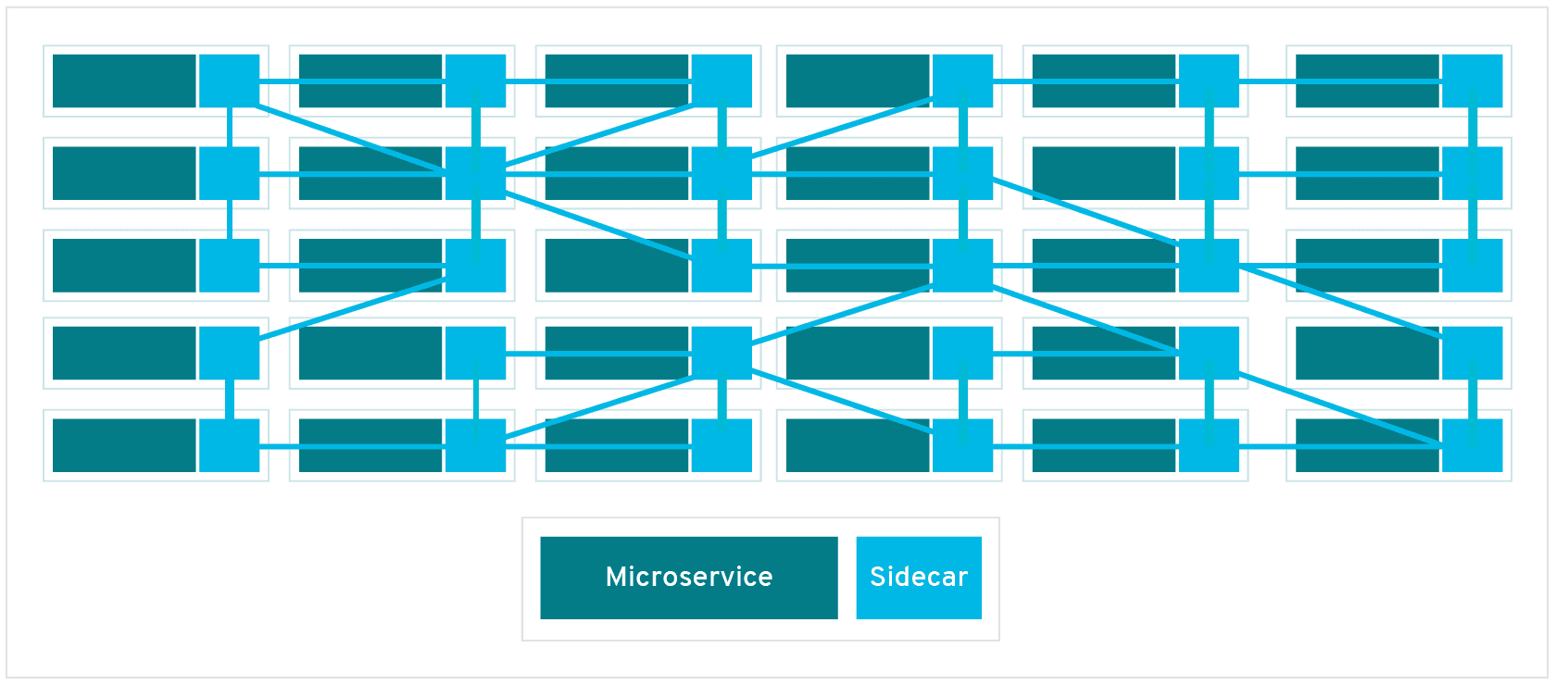
From Microservices to Service
Microservices platforms define and organize the microservices in such a way that they become standard components for composition.
Computer organization have a few micro instructions:
Analogy: microinstruction vs. instruction
IF, ID, EX, MEM, WB
A program consists of microinstructions
Service Mesh: You select micro services combination to define your application
Sidecar or Proxies
https://www.redhat.com/en/topics/microservices/what-is-a-service-mesh

Slide 42
Microservices Platforms
Istio is an open source service mesh platform that provides a way to control how microservices share data with one another. https://www.redhat.com/en/topics/microservices/what-is-istio. It includes
APIs that let Istio integrate into any logging platform.
Its architecture is divided into the data plane and the control plane to implement the slidecar (proxy) and service container concepts.
Changing an application is about changing the mesh network
Spring Framework / Spring Cloud: A Java-based microservice architecture that support Servlet API, WebSocket API, JSON Binding API, RESTful service, etc., integration; (https://spring.io/projects/spring-cloud)
It provides tools for developers to quickly build some of the common patterns in distributed systems (e.g. configuration management, service discovery, circuit breakers, intelligent routing, micro-proxy, control bus, one-time tokens, global locks, leadership election, distributed sessions, cluster state).
Coordination of distributed systems leads to boilerplate patterns (frequently used code), and can quickly stand up services and applications that implement those patterns.

Slide 43
Lecture Summary
HTTP and REST Concept
RESTful Services
From SOAP service to RESTful Service
With full implementation detail
When to use SOAP services and when to use RESTful services
Focus on computing/method
Focus on results
Processing URI string in RESTful service
Mapping URI string to operations
RESTful service’s Output formats
Microservices Architecture and Service Mesh

Slide 44
Next RESTful Lecture
Developing REST Services:
Developing RESTful Service
Defining Input and Output Formats
Image Verifier in RESTful Service
RESTful Service of a Random String Generator
RESTful Service of an Image Verifier
Synchronous RESTful Service Calls
Consuming Services
Asynchronous SOAP Calls
Asynchronous RESTful Calls

